Slide 1
Italy – the perfect golfing retreat
By Callum O’Neill

Slide 2



Contents
Why Italy for golf?
Weather Analysis
Recommendations

Slide 3
Why Italy?
Golf in Italy has a long tradition
Around 261 courses
Ryder cup in 2022
Best time to go?

Slide 4
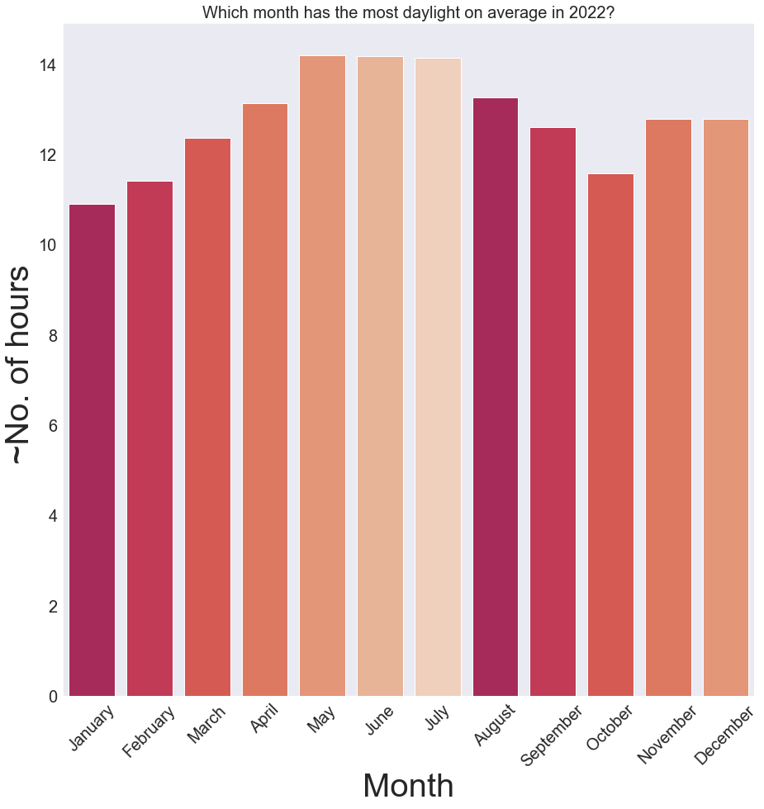
Weather: daylight
Which month has the greatest amount of daylight?
Months with most daylight:
May, June, July
~14 hours (avg) of daylight for each of the 3 months

Slide 5
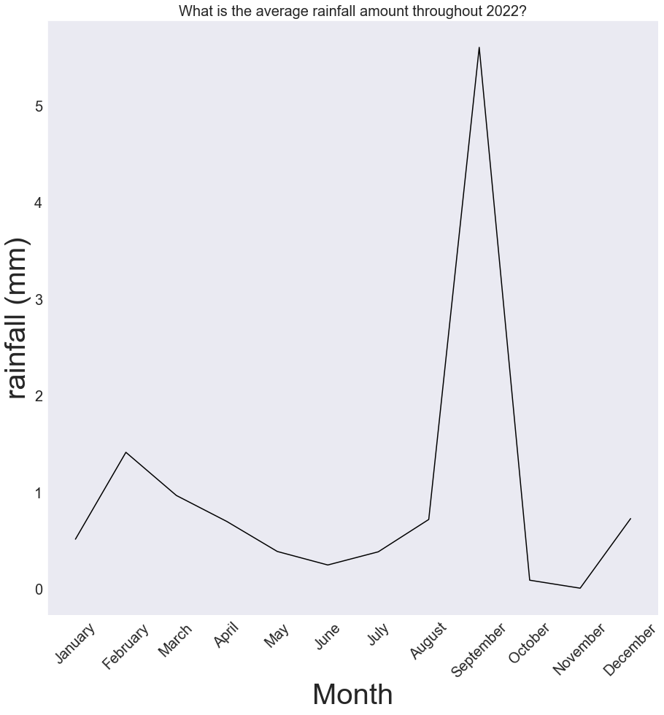
Weather: rainfall
What is the average amount of rainfall throughout 2022
Month with heaviest rainfall:
September
~47.6%
~5.6mm of rainfall
Month with least rainfall;
November: 0.01mm

Slide 6
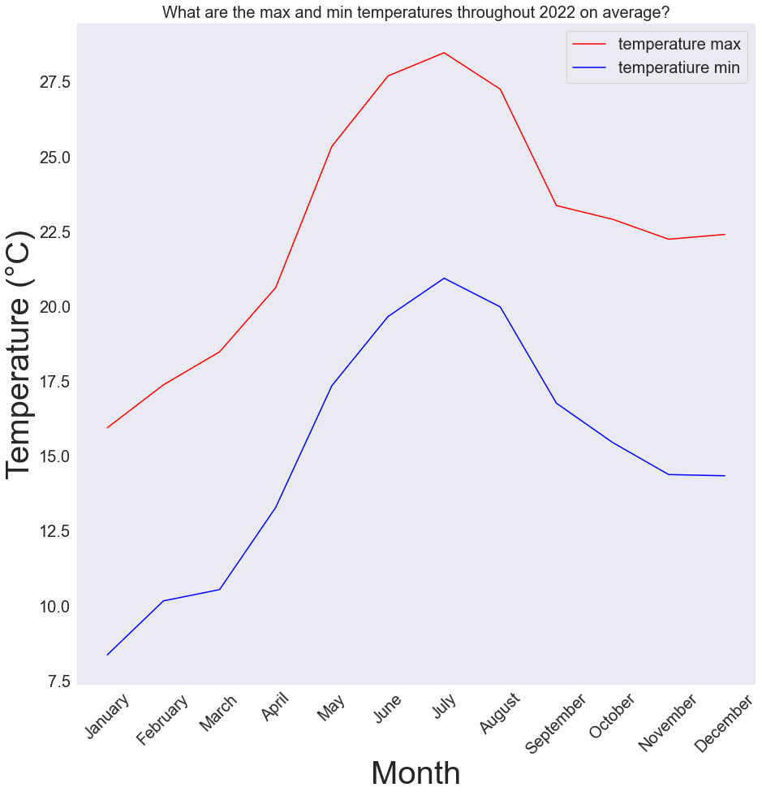
Weather: max and min temperature
What are the max and min temperatures throughout 2022?
Hottest:
July
~28°C and ~21 °C
(Max + Min)
Coolest:
January
~16°C and ~8 °C
(Max + Min)

Slide 7
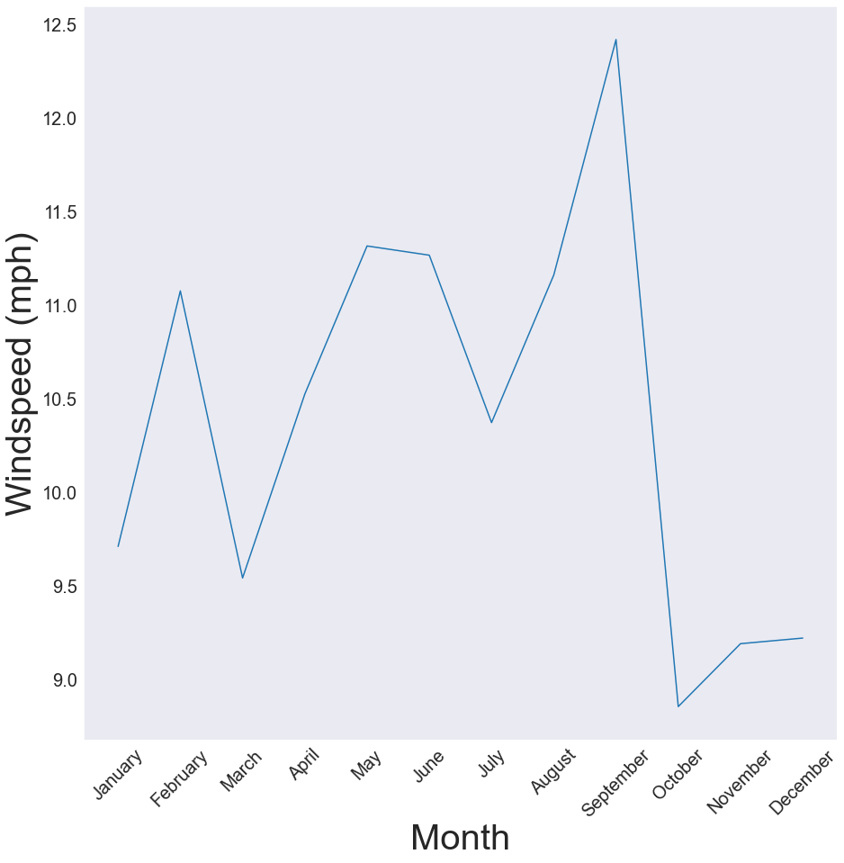
Which has the strongest winds on average?
Weather: Winds
Strongest winds:
September
Weakest winds:
October

Slide 8
Conclusion
July, October, November
Agrees with Leading Courses Website

Slide 9
Thanks for listening!

